Slide 1
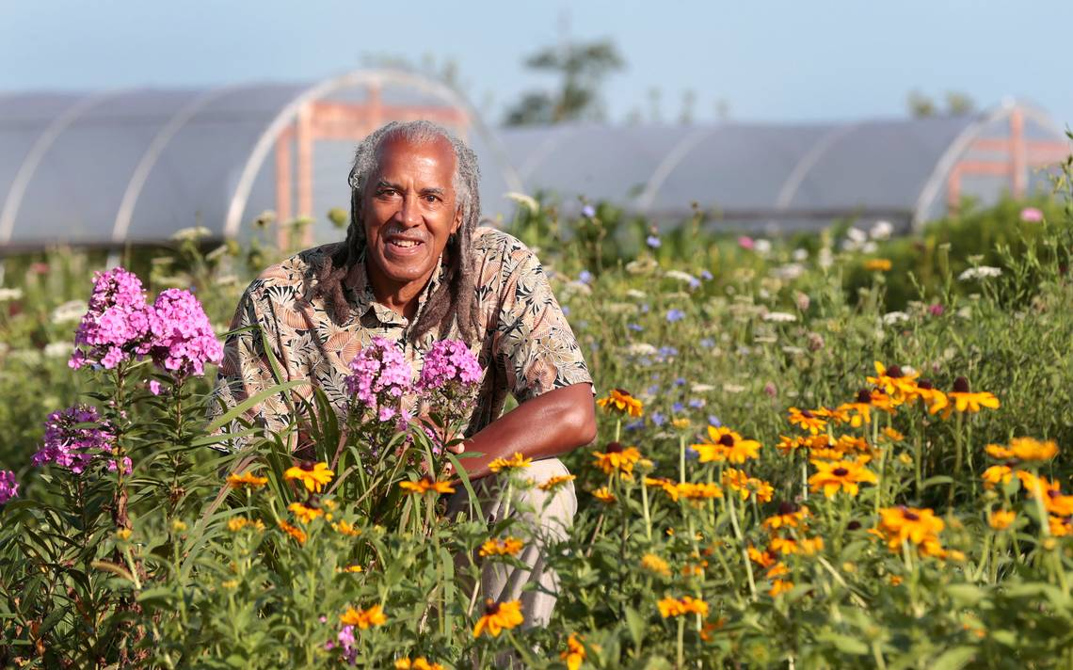
Greene Scholars- Summer Science Institute
Jim Embry
sustainlex.org
embryjim@gmail.com

Slide 2
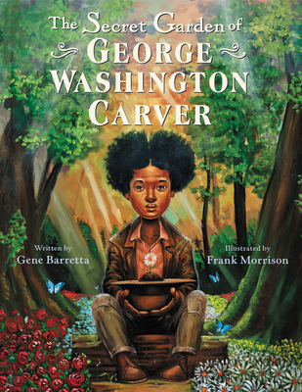

Slide 3
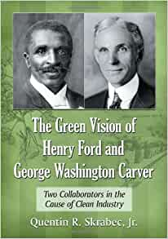
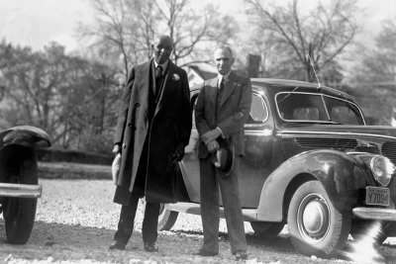
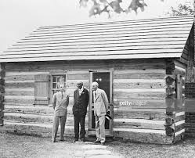

Slide 5
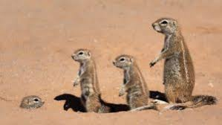
Small Groups
Peanut Group… Sweet Potato Group….Soybean Group Flower Group…Fungi Group
Questions for Breakout rooms:
What were the primary elements of Carver and Ford’s Green Vision? Are they relevant today?

Slide 6
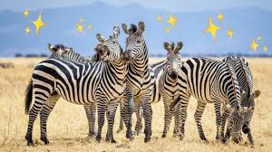
Small group report back

Slide 7
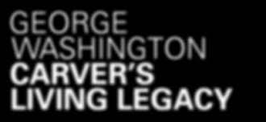
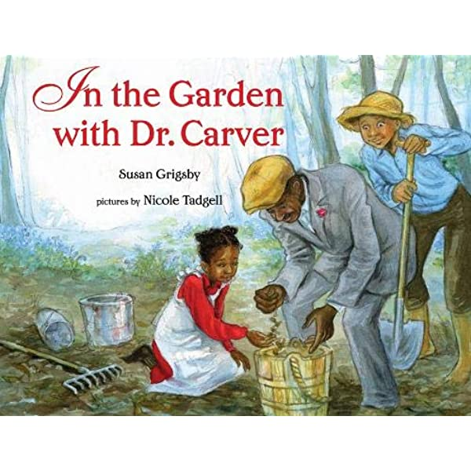
Life Principles
Zero waste
Simple living
Devotion to nature study
Healthy diets/soil
Local food
Organic food
Spiritual practice

Slide 8
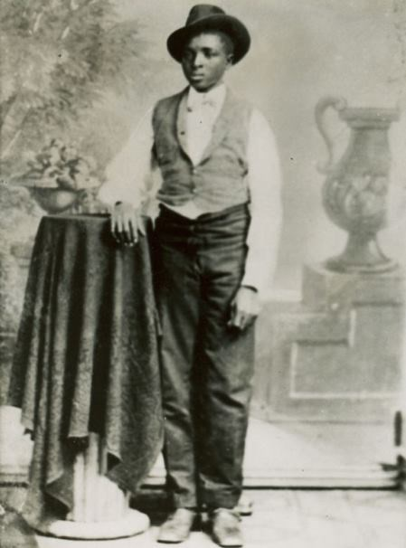
Being inclusive
Children to adults
Peasant Sharecroppers to Presidents
Farmers to scientists Edison
Workers to owners Henry Ford
Talk to plants
Message for everyone

Slide 9
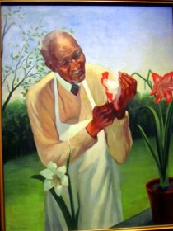
Jessup wagon
Education to the people
Environmental justice
Food Justice
Restorative Justice
Injustice to soil is injustice to people
Begin with the soil

Slide 10
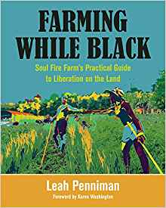

Slide 12
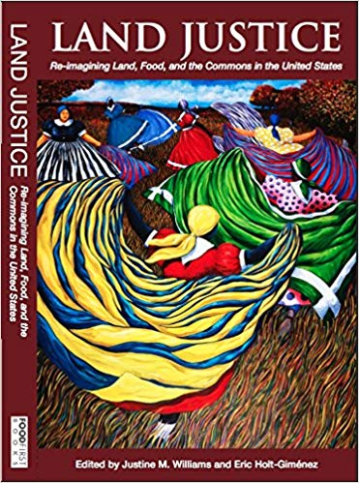
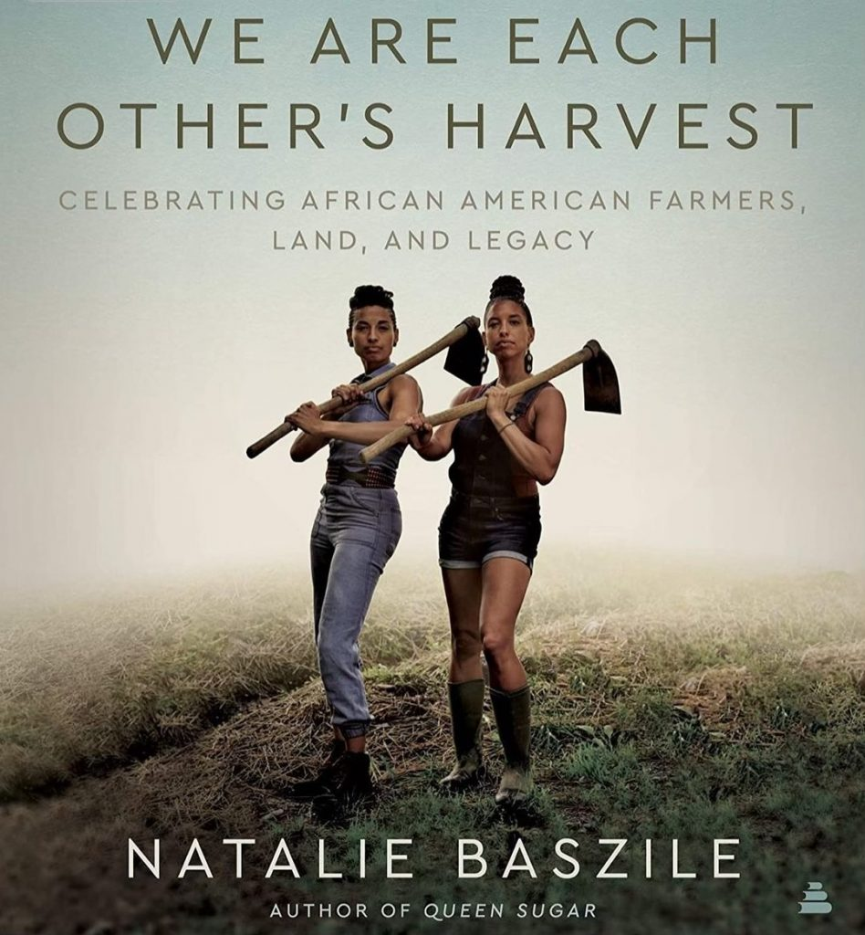
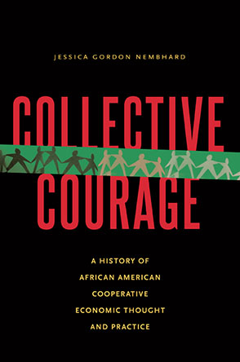

Slide 14
Farms to Grow, Inc.
Grow It, Eat It, Love It!

Slide 15
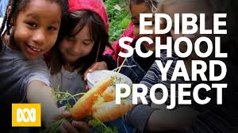

Slide 16
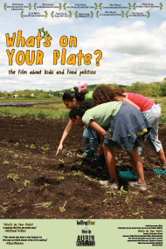

Slide 17
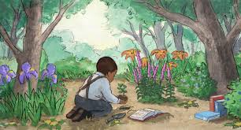
Notes:
Relevance No. 1
Most of George Washington Carver’s entire life was devoted to nature study. There is probably no better example of how nature study can impact an individual’s life than Carver’s life. As an enslaved and very sickly child, Carver was allowed to spend most of his time in the garden, in the woods. The world of nature was his playmate and teacher. He was allowed to spend hours and hours of his day in the fields, streams and in the forests observing plants, flowers, insects…..observing all of nature around him. So his love of nature and his life long study of nature came quite naturally even before he had formal schooling. We might say that Carver was an early advocate and practioner of nature based early learning even as a child.
Today as we seek to become even more inclusive in this nature based learning work there is no better example…no better role model…no better person to emulate than George Washington Carver.
His life and achievements point out very clearly that the lives of our children will mattereven more when commit as a country to make sure our children spend lots of time outdoors in nature.

Slide 21
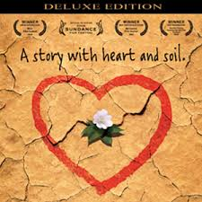
DIRT the movie
Notes:
I recommend if you haven‘t seen it already that you find a copy of “DIRT-- the movie” and show it in your community or in your schools. it is a delightful movie with some animation and features global personalities and cultures

