Slide 1
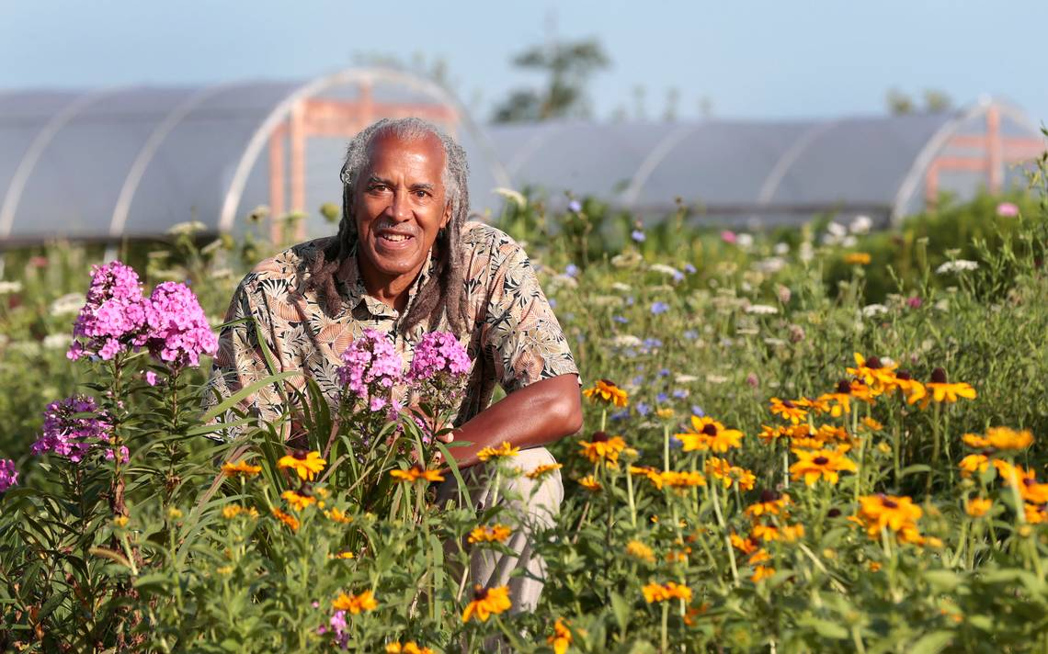
Greene Scholars- Summer Science Institute
Jim Embry
sustainlex.org
embryjim@gmail.com

Slide 2
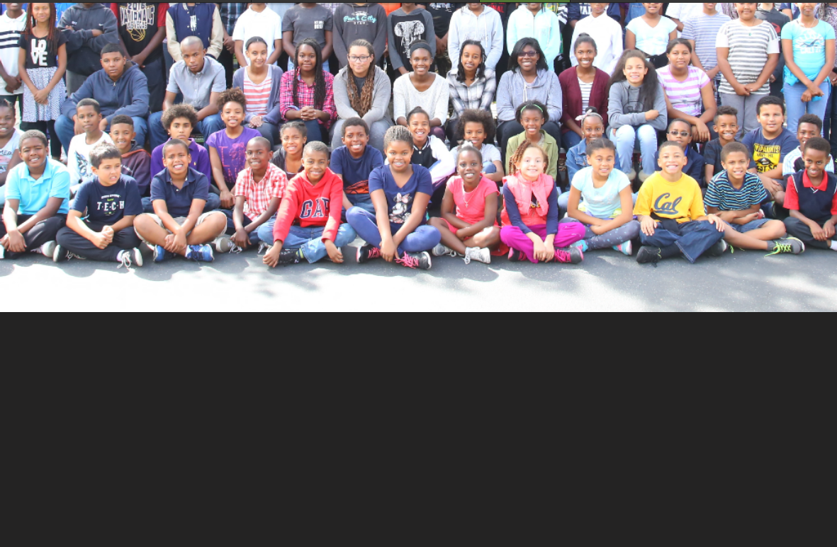

Slide 3
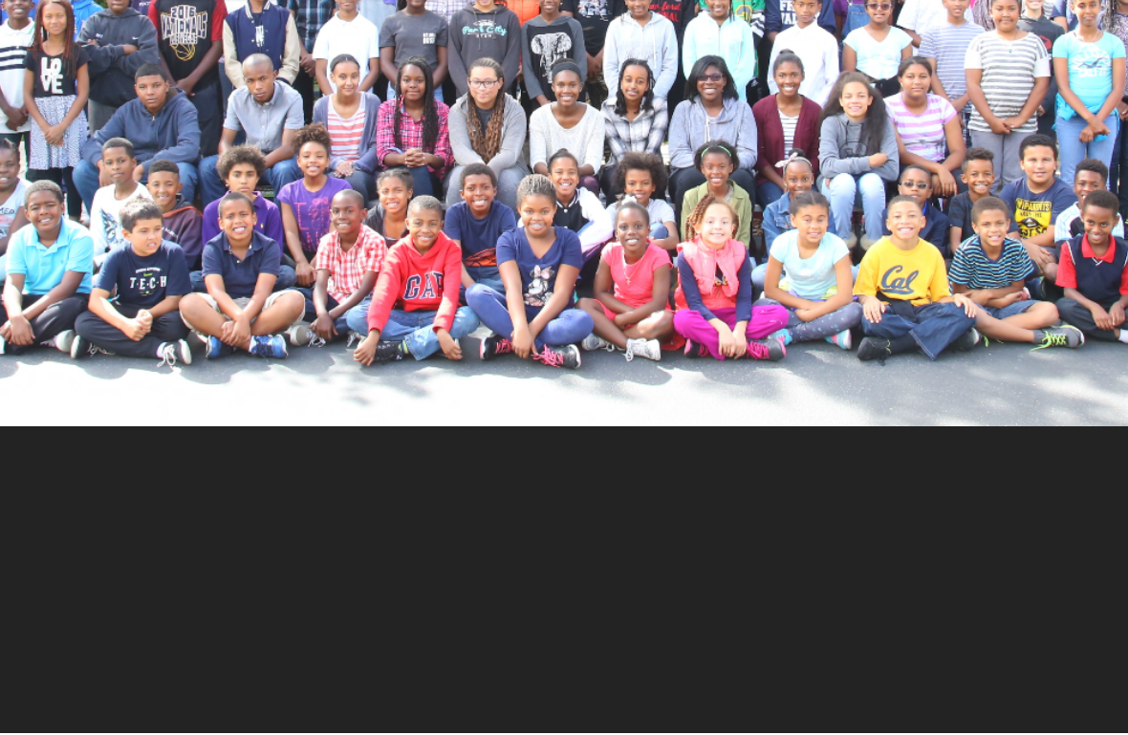
Inspiration
Motivation
Imagination

Slide 4
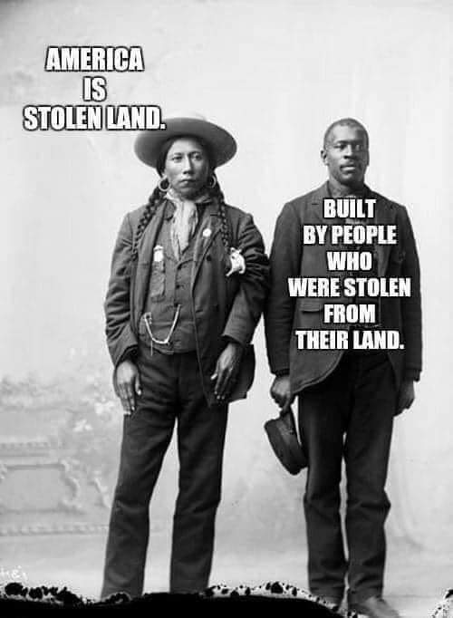
Stolen Land Stolen Labor for Agriculture

Slide 5
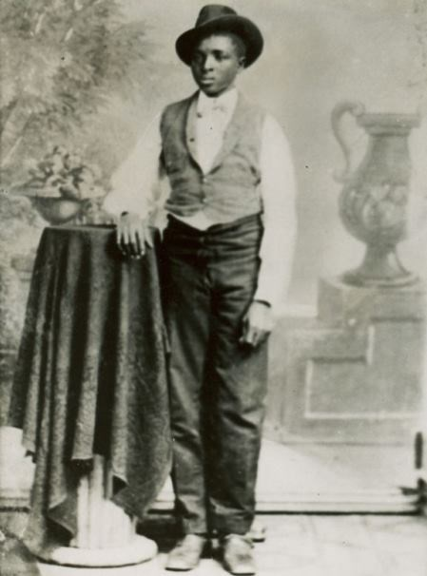
George Washington Carver 1879 about 14 years old

Slide 6
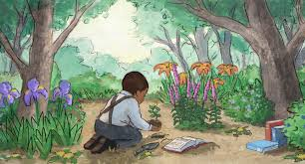

Slide 7
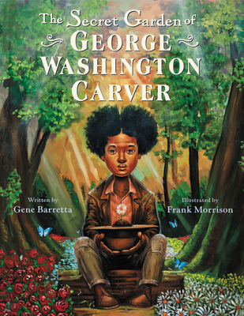

Slide 8
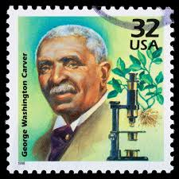
RELEVANCE
Life of STEM or STEAM
A for arts
Agriculture was foundation
Combined science and religion/spirituality
Education for entire community
Relate to peasants and presidents

Slide 9
Black Lives Mattered
Left faculty at Iowa State
47 years at Tuskegee
wrote 47 bulletins for Black /farmers/sharecroppers
Gave 1000s of speeches to Black farmers/teachers
Created products for economic well being of Black community

Slide 10
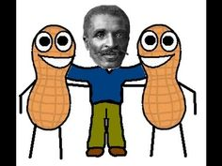
Black Souls
Black Soils
George Washington Carver

Slide 11
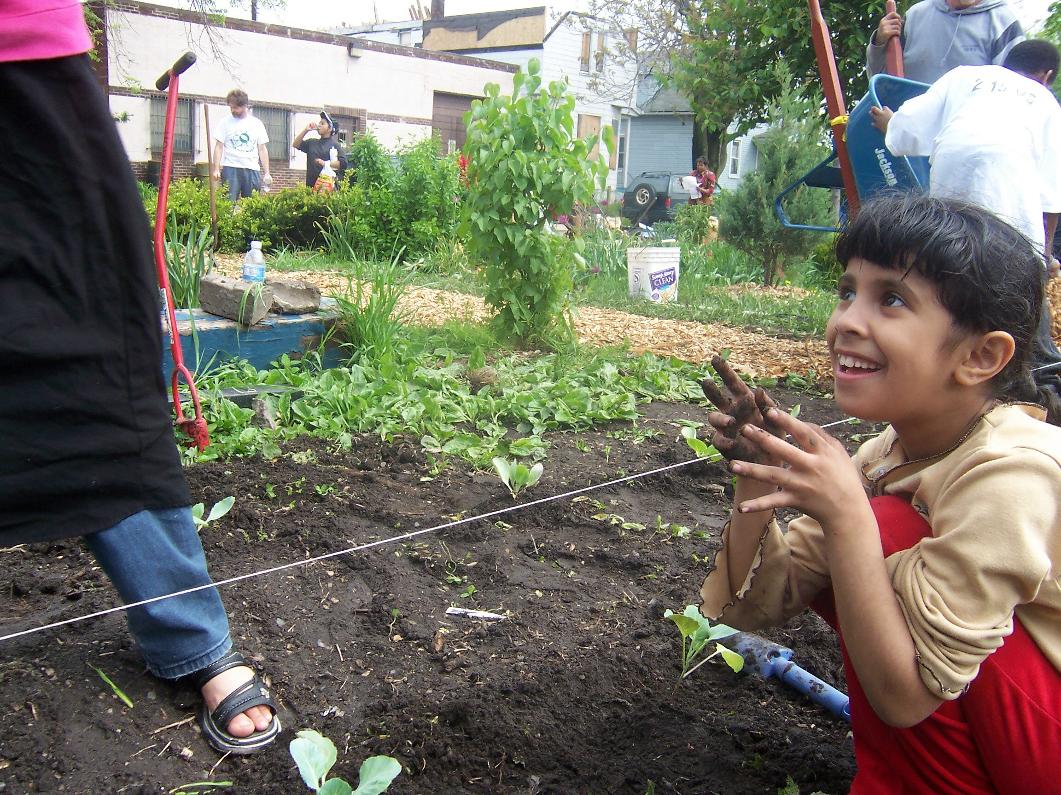
Black Souls and Black Soil

Slide 12
DIRT the movie
Notes:
I recommend if you haven‘t seen it already that you find a copy of “DIRT-- the movie” and show it in your community or in your schools. it is a delightful movie with some animation and features global personalities and cultures

Slide 15
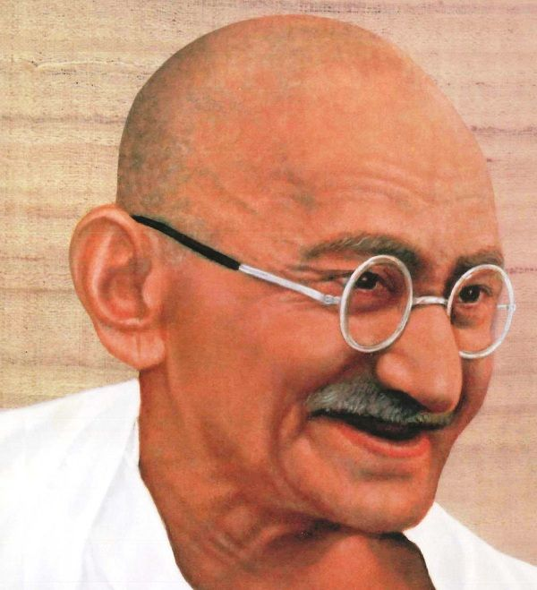
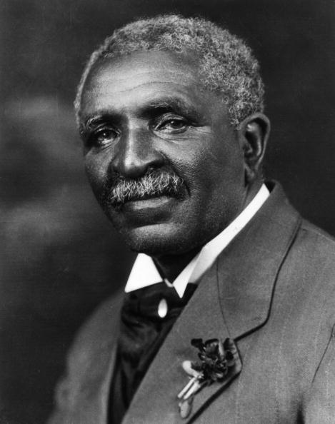
"My beloved friend, Mr. Gandhi," Carver provided advice about adding additional soy in his diet and other ways to enhance nutrition.
Notes:
the very first African American that Gandhi became close to was George Washington Carver. They never met in person but by mail. They began corresponding around 1929 and continued until Carvers death in 1943. While lecturing on satyagraha at Tuskegee in 1929, one of Gandhi’s closest friends, Charles Andrews, befriended Carver Through many hours of discussion with Charles Freer Andrews, George Washington Carver developed his own Christian interpretation of satyagraha, or soul-force. When Andrews returned to India, Gandhi was so impressed by what he heard about Carver that he asked his friend to write an article on him so that Indians could learn from Carver’s example
It is Carver who encouraged Howard Thurman to make his trip to India in 1935 and to meet up with Gandhi. And it was Carver who encouraged Benjamin Mays to make a similar trip in 1936.
So this line of nonviolent philosophy ties all these folks together.
Carver viewed his support of India’s farmers as support for the Indian freedom struggle. More food and of higher quality would translate into a stronger Indian population that was more capable of fighting for their freedom. Carver sent Gandhi a special diet that he hoped would give Gandhi more strength with which to fight for his people. There was also a religious dimension to Carver’s support of Gandhi: both men viewed farming not only as a tool that allowed oppressed communities to be more independent, but also as a sacred connection to the land that brought people closer to God’s miracle. For Gandhi, this meant that agricultural work could potentially help people gain the spiritual strength necessary for nonviolent resistance. Gandhi and Carver also urged the poor to avoid purchasing what they could make for themselves, partly so they could gain economic independence, and partly so that they could develop a faith in their abilities that would make them spiritually stronger.
Gandhi 1869 1948
Carver 1860-1943
Around 1929 a close of associate of Gandhi was touring the USA and stopped to speak at Tuskegee Institute where he met and became frieds with Carver.

Slide 16
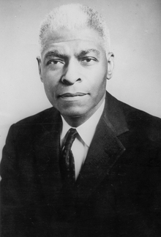
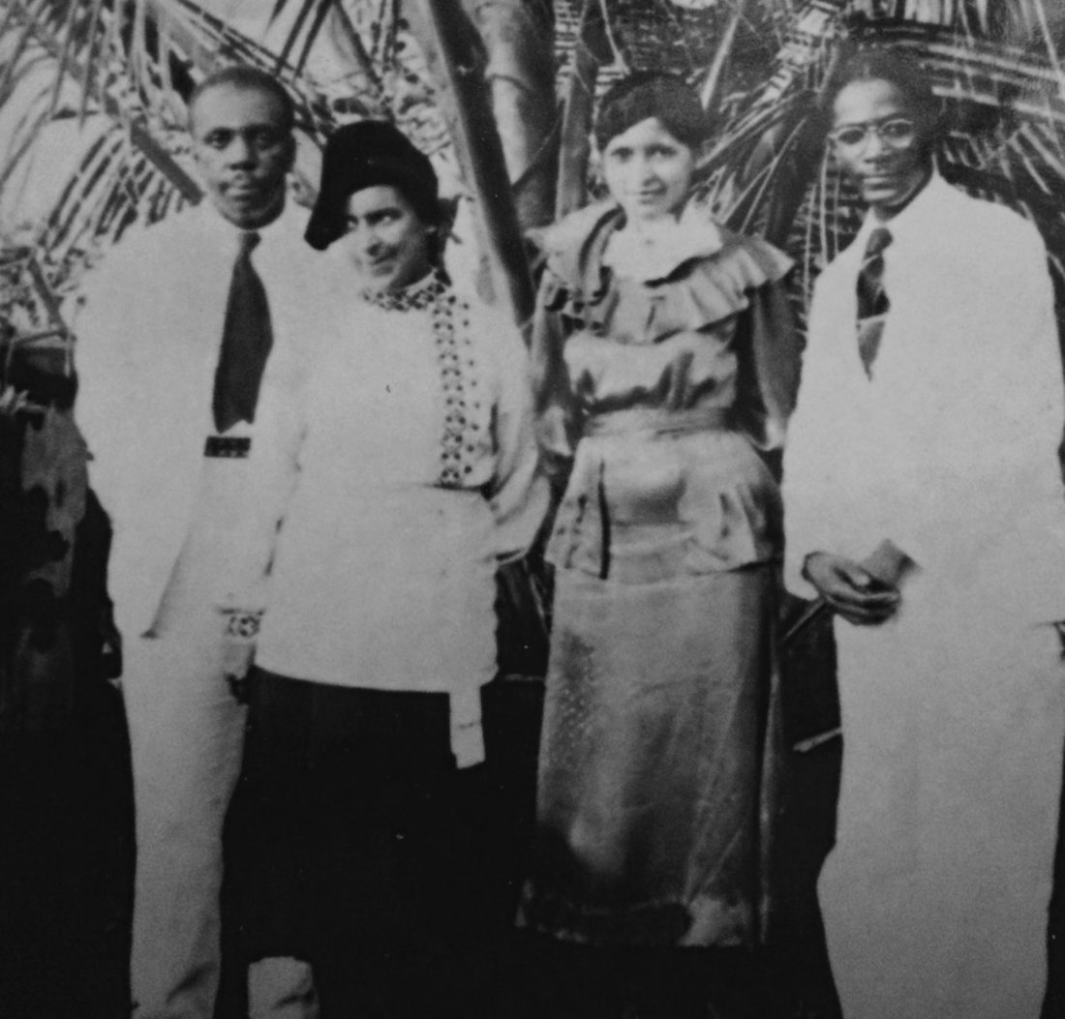
Howard
& Kate Thurman
Benjamin Mays
Notes:
On the left here is a picture of Howard Thurman and his wife, Sue Bailey on their trip to India in 1935. During this trip they met up with Gandhi for long conversations and also delivered a message from Gandhi’s dear American friend, George Washington Carver.
Thurman had visited Tuskegee several times and had become a mentee of Carver. Carver encouraged Thurman to make this trip to Indiaand be sure to meet up with his dear friend.
On the right is a photo of Benjamin Mays who was DR King’s Mentor who also went to India to study with Gandhi.
Both of these men advised Dr. King on the philosophy of Gandhi. Both men also got access to Gandhi because of Gandhi’s friendship, respect and love for Carver and vis versa
Carver had shared with Rev Thurman his friendship with and respect for Gandhi. Carver mentioned that he and Gandhi shared a mutual commitment to nonviolence.

Slide 17
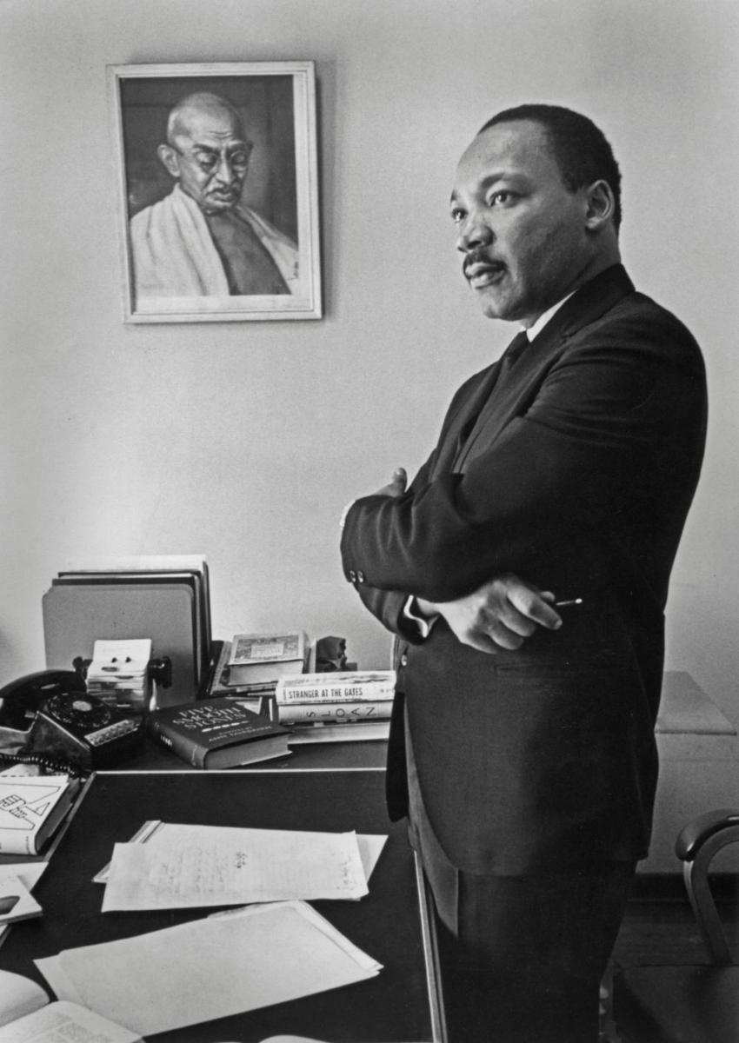

Slide 18
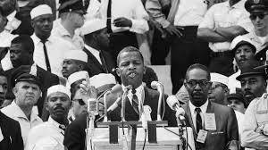
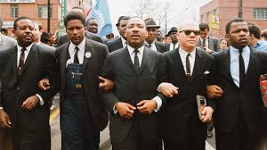
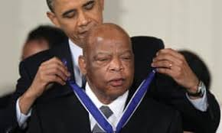
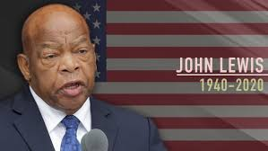
Notes:
Just yesterday we watched the final services for John Lewis and this is where I share my last Carver Legacy. John Lewis said that he was inspired by Dr. King to get involved in the nonviolent freedom struggle when he was a teen. And he know how John Lewis held true to those principles throughout his life

Slide 19
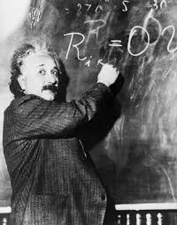
Physicist, Albert Einstein considered Carver one of the ten greatest scientists of all time.

Slide 20
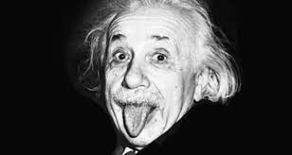

Slide 21
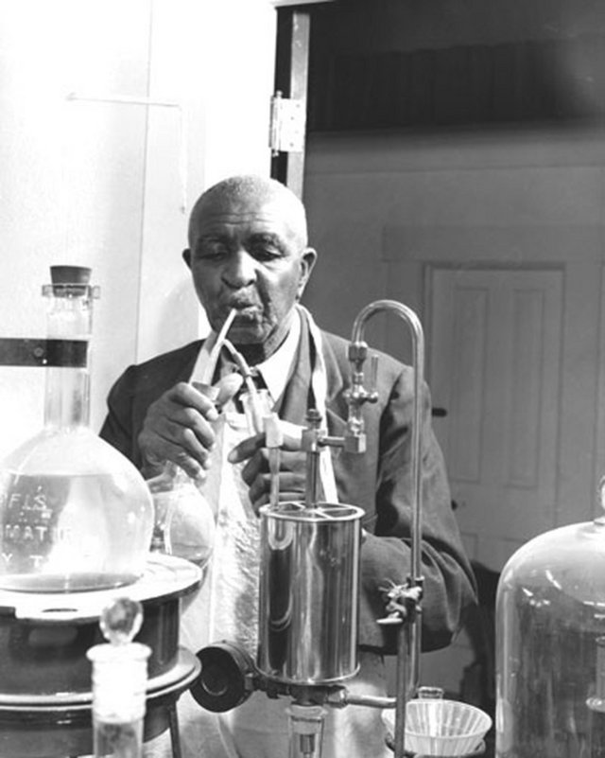
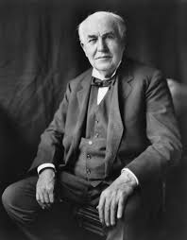
Carver in his laboratory
Thomas Edison
Notes:
Carver was also friends with Thomas Edison and was offered a position to lead Edison’s research laboratory. But Carver declined because he was committed to Tuskegee and his people in the South

Slide 22
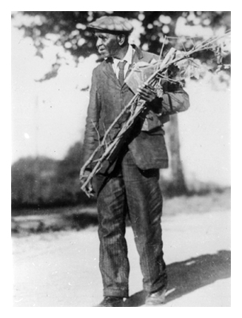
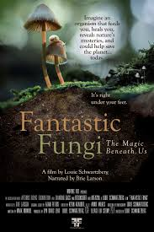
One of USA’s foremost MYCOLOGIST

Slide 23
Cercospora carveriana
Metasphaeria carveri
Pestalotia carveri
Taphrina caveri

Slide 24
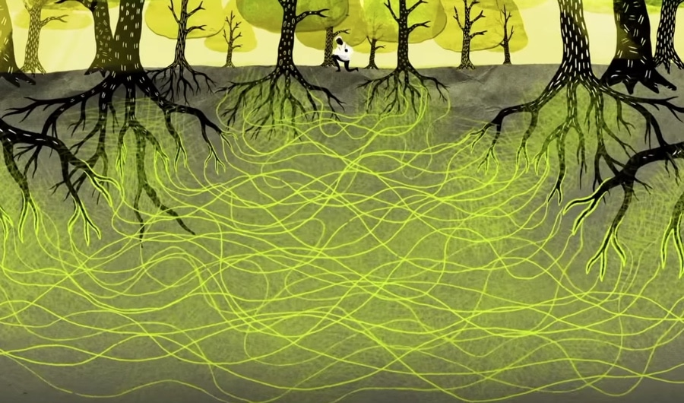
Wood Wide Web

Slide 25
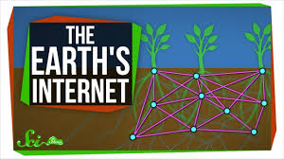

Slide 26
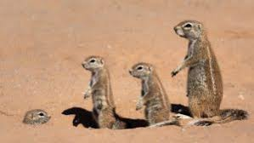
Small Groups
Peanut Group… Sweet Potato Group….Soybean Group Flower Group…Fungi Group
Questions: - What new things have you learned about GW Carver’s life? How does his life inspire you? What lessons can Greene Scholars apply from Carver’s life?

Slide 27
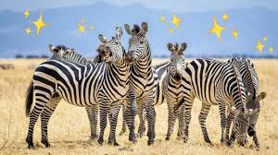
Small group report back

Slide 28
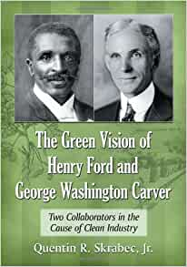
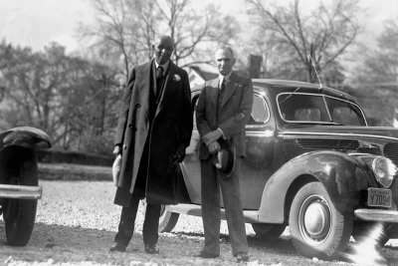
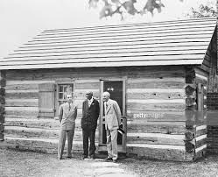
Notes:
Relevance No 8
Ford and Carver shared a Green vision for the USA, that combined industrial manufacturing with agricultural production. Worked. This vision included just in time manufacturing, zero waste, biofuels, They also worked together to incorporate nature study in schools and communities. Their green vision, implemented in some ways, is still quite relevant today

Slide 30
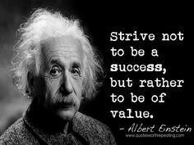

Slide 31
No individual has any right to come into the world and go out of it without leaving behind him distinct and legitimate reasons for having passed through it

